Slide 1

Performance Improvements in .NET 5
Stephen Toub
.NET Community Stand-up

Slide 2
.NET Performance
Previous .NET Core releases saw big gains
Performance Improvements in .NET Core
Performance Improvements in .NET Core 2.1
Performance Improvements in .NET Core 3.0
ASP.NET Core: Saturating 10GbE at 7+ million request/s
.NET 5 sees more big gains
Hundreds of perf-related PRs up and down the stack
Performance Improvements in .NET 5

Slide 3
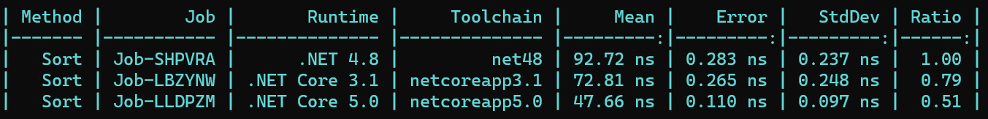
Porting Native Runtime Code to Managed
e.g. Moved primitives sorting to C# (dotnet/coreclr#27700)
private int[] _orig = Enumerable.Range(0, 10).Reverse().ToArray();
private int[] _array = new int[10];
[Benchmark]
public void Sort()
{
_orig.CopyTo(_array, 0);
Array.Sort(_array);
}

Slide 4
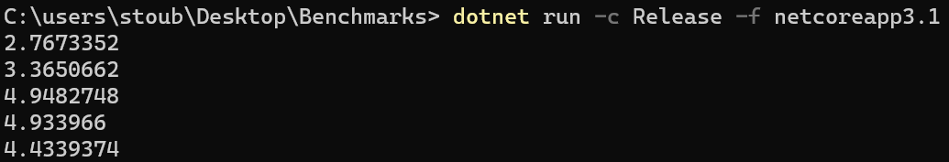
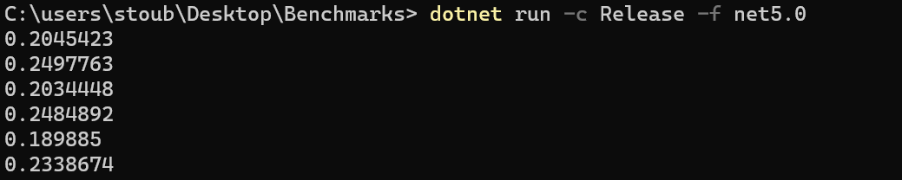
Porting Native Runtime Code to Managed, cont.
GC pause time
using System;
using System.Diagnostics;
using System.Threading;
class Program
{
public static void Main()
{
new Thread(() =>
{
var a = new int[20];
while (true) Array.Sort(a);
})
{ IsBackground = true }.Start();
var sw = new Stopwatch();
while (true)
{
sw.Restart();
for (int i = 0; i < 10; i++)
{
GC.Collect();
Thread.Sleep(15);
}
Console.WriteLine(sw.Elapsed.TotalSeconds);
}
}
}

Slide 5
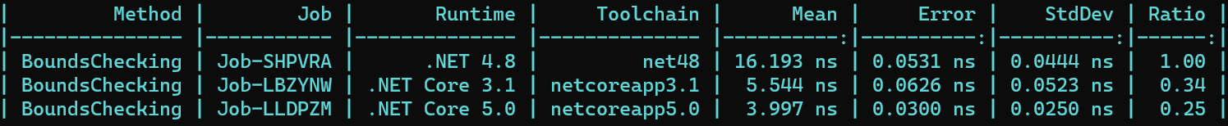
JIT
Bounds checking improvement
e.g. eliminating them for several additional patterns now common with spans (dotnet/runtime#1644)
[Benchmark]
public bool BoundsChecking() => TryToHex(int.MaxValue, _buffer);
private static bool TryToHex(int value, Span<char> span)
{
if ((uint)span.Length <= 7)
return false;
ReadOnlySpan<byte> map = new byte[]
{
(byte)'0', (byte)'1', (byte)'2', (byte)'3',
(byte)'4', (byte)'5', (byte)'6', (byte)'7',
(byte)'8', (byte)'9', (byte)'A', (byte)'B',
(byte)'C', (byte)'D', (byte)'E', (byte)'F'
};
span[0] = (char)map[(value >> 28) & 0xF];
span[1] = (char)map[(value >> 24) & 0xF];
span[2] = (char)map[(value >> 20) & 0xF];
span[3] = (char)map[(value >> 16) & 0xF];
span[4] = (char)map[(value >> 12) & 0xF];
span[5] = (char)map[(value >> 8) & 0xF];
span[6] = (char)map[(value >> 4) & 0xF];
span[7] = (char)map[value & 0xF];
return true;
}
private char[] _buffer = new char[100];
; .NET Core 3.1
mov eax,ecx
sar eax,4 ; value >> 4
and eax,0F ; & 0xF
cmp eax,10 ; if (result >= map.Length)
jae short M01_L01 ; goto failure
movsxd rax,eax
movzx eax,byte ptr [rax+rdx] ; map[result]
mov [r8+0C],ax ; store char into span[6]
; .NET 5
mov eax,ecx
sar eax,4 ; value >> 4
and eax,0F ; & 0xF
movsxd rax,eax
movzx eax,byte ptr [rax+rdx] ; map[result]
mov [r8+0C],ax ; store char into span[6]

Slide 6
JIT, cont.
Type and covariance checking improvements
e.g. make typeof(T).IsValueType a JIT-time constant (dotnet/runtime#1157)
e.g. optimizing obj.GetType() != typeof(X) on sealed classes (dotnet/runtime#32790)
// B and C derive from A
var values = new B[42];
var span = new Span<A>(values);
ref A valueRef = ref span[0];
valueRef = new C(); // UH OH!
public Span(T[]? array)
{
...
if (!typeof(T).IsValueType && array.GetType() != typeof(T[]))
ThrowHelper.ThrowArrayTypeMismatchException();
...
}
; .NET Core 3.1
; Program.Ctor()
push rdi
push rsi
push rbp
push rbx
sub rsp,28
mov rsi,rdx
mov rdi,[rcx+8]
test rdi,rdi
jne short M00_L00
xor ebx,ebx
xor ebp,ebp
jmp short M00_L01
M00_L00:
mov rcx,rdi
call System.Object.GetType()
mov rbx,rax
mov rcx,7FFA721F2602
call CORINFO_HELP_TYPEHANDLE_TO_RUNTIMETYPE
cmp rbx,rax
jne short M00_L02
lea rbx,[rdi+10]
mov ebp,[rdi+8]
M00_L01:
mov [rsi],rbx
mov [rsi+8],ebp
mov rax,rsi
add rsp,28
pop rbx
pop rbp
pop rsi
pop rdi
ret
M00_L02:
call System.ThrowHelper.ThrowArrayTypeMismatchException()
int 3
; Total bytes of code 88
; .NET 5
; Program.Ctor()
mov rax,[rcx+8]
test rax,rax
jne short M00_L00
xor ecx,ecx
xor r8d,r8d
jmp short M00_L01
M00_L00:
lea rcx,[rax+10]
mov r8d,[rax+8]
M00_L01:
mov [rdx],rcx
mov [rdx+8],r8d
mov rax,rdx
ret
; Total bytes of code 35
[Benchmark]
public Span<string> Ctor() => new Span<string>(_array);
private string[] _array = new string[42];

Slide 7
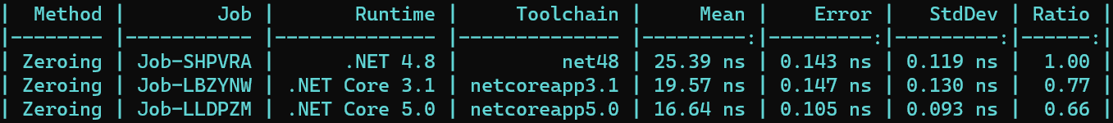
JIT, cont.
Zero'ing improvements (making it faster, removing it, etc.)
e.g. vectorizing zero'ing (dotnet/runtime#32538)
[Benchmark]
public int Zeroing()
{
ReadOnlySpan<char> s1 = "hello world".AsSpan();
ReadOnlySpan<char> s2 = Nop(s1);
ReadOnlySpan<char> s3 = Nop(s2);
ReadOnlySpan<char> s4 = Nop(s3);
ReadOnlySpan<char> s5 = Nop(s4);
ReadOnlySpan<char> s6 = Nop(s5);
ReadOnlySpan<char> s7 = Nop(s6);
ReadOnlySpan<char> s8 = Nop(s7);
ReadOnlySpan<char> s9 = Nop(s8);
ReadOnlySpan<char> s10 = Nop(s9);
return s1.Length + s2.Length + s3.Length + s4.Length + s5.Length +
s6.Length + s7.Length + s8.Length + s9.Length + s10.Length;
}
[MethodImpl(MethodImplOptions.NoInlining)]
private static ReadOnlySpan<char> Nop(ReadOnlySpan<char> span) => default;
; .NET Core 3.1
; Program.Zeroing()
push rdi
push rsi
sub rsp,0C8
mov rsi,rcx
lea rdi,[rsp+28]
mov ecx,28
xor eax,eax
rep stosd
mov rcx,rsi
mov rcx,19710009B40
mov rcx,[rcx]
test rcx,rcx
jne short M00_L00
xor edx,edx
xor esi,esi
jmp short M00_L01
; .NET 5
; Program.Zeroing()
push rsi
sub rsp,0C0
vxorps xmm4,xmm4,xmm4
vmovdqa xmmword ptr [rsp+20],xmm4
mov rax,0FFFFFFFFFF70
M00_L00:
vmovdqa xmmword ptr [rsp+rax+0C0],xmm4
vmovdqa xmmword ptr [rsp+rax+0D0],xmm4
vmovdqa xmmword ptr [rsp+rax+0E0],xmm4
add rax,30
jne short M00_L00
mov rcx,1FE10009B98
mov rcx,[rcx]
test rcx,rcx
jne short M00_L01
xor edx,edx
xor esi,esi
jmp short M00_L02
M00_L01:

Slide 8
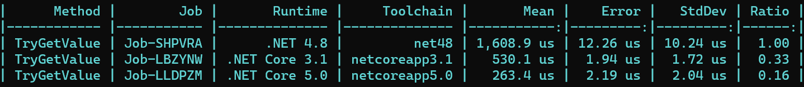
Collections
Every meaningful app uses collections, e.g. Dictionary<>
Improve Dictionary TryGetValue size/performance by benaadams · Pull Request #27195 · dotnet/coreclr (github.com)
Even faster modulo computation by AntonLapounov · Pull Request #406 · dotnet/runtime (github.com)
Improve dictionary lookup perf for OrdinalIgnoreCase by GrabYourPitchforks · Pull Request #36252 · dotnet/runtime (github.com)
private Dictionary<string, int> _d = Enumerable.Range(0, 10_000).ToDictionary(i => Guid.NewGuid().ToString(), i => i, StringComparer.OrdinalIgnoreCase);
private string[] _keys;
[GlobalSetup]
public void Setup() => _keys = _d.Keys.ToArray();
[Benchmark]
public int TryGetValue()
{
int count = 0;
foreach (string s in _keys)
if (_d.TryGetValue(s, out _))
count++;
return count;
}

Slide 9
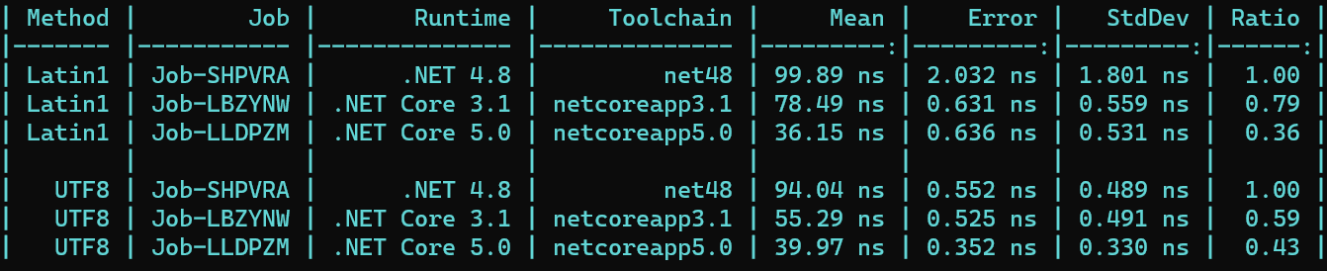
Text Processing
Parsing, Formatting, Casing, Searching, Encoding, …
e.g. primitive ToString/TryFormat (dotnet/runtime#32528)
e.g. UTF8 (dotnet/runtime#27268) and Latin1 (dotnet/runtime#32994)
e.g. IndexOfAny (dotnet/runtime#40729)
[Benchmark]
[Arguments(12345)]
public string Int32ToString(int i) => i.ToString();
[Benchmark] public string UTF8() => Encoding.UTF8.GetString(Encoding.UTF8.GetBytes("This is a test."));
[Benchmark] public string Latin1() => _latin1.GetString(_latin1.GetBytes("This is a test."));
private Encoding _latin1 = Encoding.GetEncoding("latin1"); // publicly exposed as Encoding.Latin1 in .NET 5
[Benchmark]
[Arguments("This is a test to see how fast it finds a period, comma, or exclamation point!", '.', ',', '!')]
public int IndexOfAny(string s, char c1, char c2, char c3) => s.AsSpan().IndexOfAny(c1, c2, c3);

Slide 10
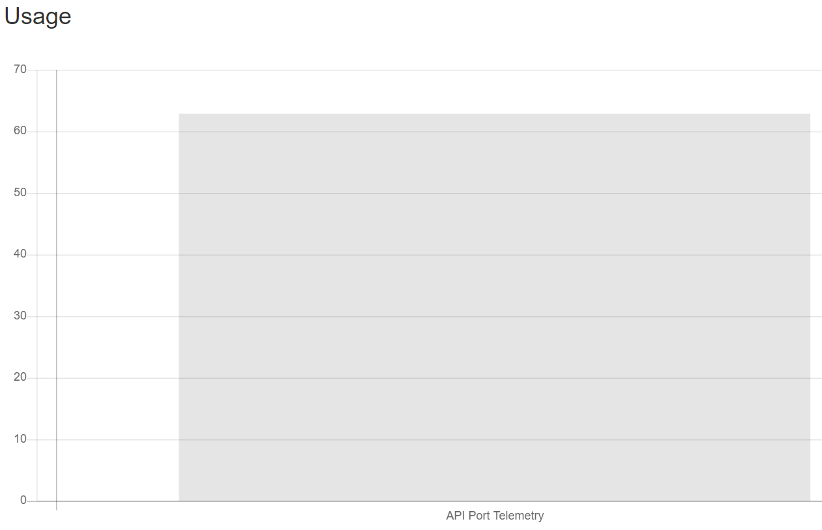
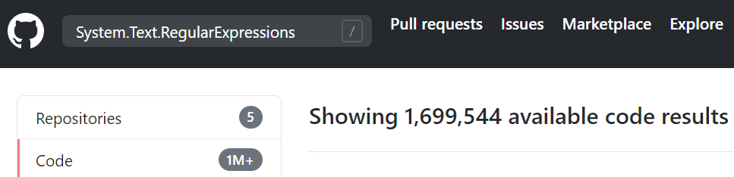
Regex
Used all over the place, e.g.
Regex - .NET API Catalog (apisof.net)
But very little investment since .NET Framework 1.1
Tons of improvements in .NET 5
Span-based vectorization
Improved code generation
Expression analysis and automatic transformation
Fast character-class lookups
…
System.Text.RegularExpressions (github.com)
Regex Performance Improvements in .NET 5 | .NET Blog (microsoft.com)

Slide 11
Regex, e.g. vectorization, character classes, …
e.g. "([ab]cd|ef[g-i])jklm"
Before
.NET 5
public override bool FindFirstChar() { int num = runtextpos; string runtext = base.runtext; int num2 = runtextend - num; if (num2 > 0) { int result; while (true) { num2--; if (!RegexRunner.CharInClass(runtext[num++], "\0\u0004\0acef")) { if (num2 <= 0) { result = 0; break; } continue; } num--; result = 1; break; } runtextpos = num; return (byte)result != 0; } return false; }
protected override bool FindFirstChar() { int runtextpos = base.runtextpos; int runtextend = base.runtextend; if (runtextpos <= runtextend - 7) { ReadOnlySpan<char> readOnlySpan = runtext.AsSpan(runtextpos, runtextend - runtextpos); for (int num = 0; num < readOnlySpan.Length - 2; num++) { int num2 = readOnlySpan.Slice(num).IndexOfAny('a', 'b', 'e'); num = num2 + num; if (num2 < 0 || readOnlySpan.Length - 2 <= num) { break; } int num3 = readOnlySpan[num + 1]; if ((num3 == 'c') | (num3 == 'f')) { num3 = readOnlySpan[num + 2]; if (num3 < 128 && ("\0\0\0\0\0\0ΐ\0"[num3 >> 4] & (1 << (num3 & 0xF))) != 0) { base.runtextpos = runtextpos + num; return true; } } } } base.runtextpos = runtextend; return false; }

Slide 12
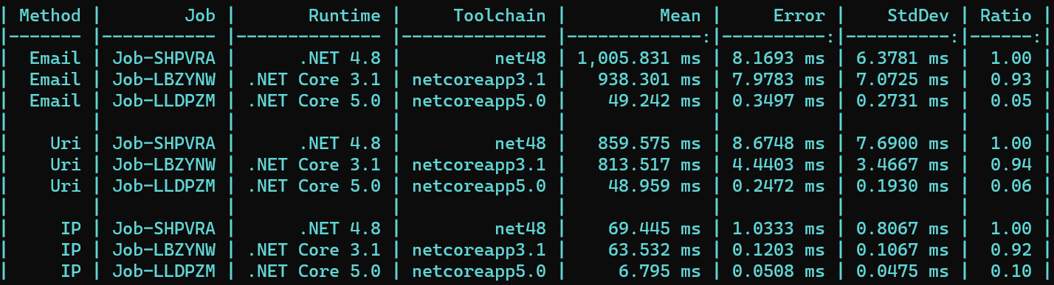
Regex, cont.
mariomka/regex-benchmark (github.com)
private Regex _email = new Regex(@"[\w\.+-]+@[\w\.-]+\.[\w\.-]+", RegexOptions.Compiled);
private Regex _uri = new Regex(@"[\w]+://[^/\s?#]+[^\s?#]+(?:\?[^\s#]*)?(?:#[^\s]*)?", RegexOptions.Compiled);
private Regex _ip = new Regex(@"(?:(?:25[0-5]|2[0-4][0-9]|[01]?[0-9][0-9])\.){3}(?:25[0-5]|2[0-4][0-9]|[01]?[0-9][0-9])", RegexOptions.Compiled);
private string _input = new HttpClient().GetStringAsync(
"https://raw.githubusercontent.com/mariomka/regex-benchmark/652d55810691ad88e1c2292a2646d301d3928903/input-text.txt").Result;
[Benchmark] public int Email() => _email.Matches(_input).Count;
[Benchmark] public int Uri() => _uri.Matches(_input).Count;
[Benchmark] public int IP() => _ip.Matches(_input).Count;

Slide 13
Networking
Uri
Reduce Uri ctor overhead by MihaZupan · Pull Request #36915 · dotnet/runtime (github.com)
Cache Uri.IdnHost and Uri.PathAndQuery by MihaZupan · Pull Request #36460 · dotnet/runtime (github.com)
Rewrite Uri.EscapeString by stephentoub · Pull Request #41772 · dotnet/corefx (github.com)
Clean up Uri.UnescapeDataString by stephentoub · Pull Request #42225 · dotnet/corefx (github.com)
Uri.UnescapeDataString and Uri.UnescapeString reuse the original string when possible by alnikola · Pull Request #41684 · dotnet/corefx (github.com)
Improve Uri.Equals by removing unsafe code by MihaZupan · Pull Request #36444 · dotnet/runtime (github.com)
Optimize Uri.GetHashCode by MihaZupan · Pull Request #32713 · dotnet/runtime (github.com)
…
HTTP
Several improvements to SocketsHttpHandler perf by stephentoub · Pull Request #41640 · dotnet/corefx (github.com)
Allow known values for HttpHeaderType.Custom in KnownHeaders by stephentoub · Pull Request #35003 · dotnet/runtime (github.com)
Add some more common response headers to KnownHeaders by stephentoub · Pull Request #34922 · dotnet/runtime (github.com)
Add Server-Timing to KnownHeaders in System.Net.Http by stephentoub · Pull Request #32989 · dotnet/runtime (github.com)
Simplify KnownHeaders lookup in SocketsHttpHandler by stephentoub · Pull Request #34974 · dotnet/runtime (github.com)
Reimplement System.Net.Http's ObjectCollection<T> to reduce allocation / interface dispatch by stephentoub · Pull Request #34902 · dotnet/runtime (github.com)
Several allocation reductions in SocketsHttpHandler by stephentoub · Pull Request #34724 · dotnet/runtime (github.com)
Optimize HttpDateParser.TryStringToDate by stephentoub · Pull Request #34860 · dotnet/runtime (github.com)
Reduce allocation in HTTP/2 requests by ~30% by stephentoub · Pull Request #32406 · dotnet/runtime (github.com)
Remove CreditManager from Http2Stream by stephentoub · Pull Request #32624 · dotnet/runtime (github.com)
Reduce simple HTTP/2 post app allocation by ~40% by stephentoub · Pull Request #32557 · dotnet/runtime (github.com)
Improve HTTP/2 scaling performance by stephentoub · Pull Request #35694 · dotnet/runtime (github.com)
More HTTP/2 performance (and a few functional) improvements by stephentoub · Pull Request #36246 · dotnet/runtime (github.com)
add write queue to Http2Connection to optimize write handling by geoffkizer · Pull Request #39166 · dotnet/runtime (github.com)
…
Sockets
Parallelize epoll events on thread pool and process events in the same thread by kouvel · Pull Request #35330 · dotnet/runtime (github.com)
Single epoll thread per 28 cores by adamsitnik · Pull Request #35800 · dotnet/runtime (github.com)
Unix: add mode to inline Socket continuations by tmds · Pull Request #37974 · dotnet/runtime (github.com)
Try using socket syscalls that accepts a single buffer to improve performance by tmds · Pull Request #36371 · dotnet/runtime (github.com)
SocketAsyncContext.Unix: remove Lock from IsReady by tmds · Pull Request #36705 · dotnet/runtime (github.com)
Avoid extra casts in SocketAsyncContext by benaadams · Pull Request #36997 · dotnet/runtime (github.com)
Remove a couple allocations from Socket.Connect/Bind/etc. by stephentoub · Pull Request #32271 · dotnet/runtime (github.com)
Remove lock allocation from SafeSocketHandle on Windows by stephentoub · Pull Request #32275 · dotnet/runtime (github.com)
Refactor Task Socket.ConnectAsync methods to use AwaitableSocketAsyncEventArgs by tmds · Pull Request #787 · dotnet/runtime (github.com)
Use pinned arrays in Sockets by VSadov · Pull Request #34175 · dotnet/runtime (github.com)
Socket.Unix: stackalloc IoVector/GCHandle for multi-buffer send/receives. by tmds · Pull Request #37583 · dotnet/runtime (github.com)
…

Slide 14
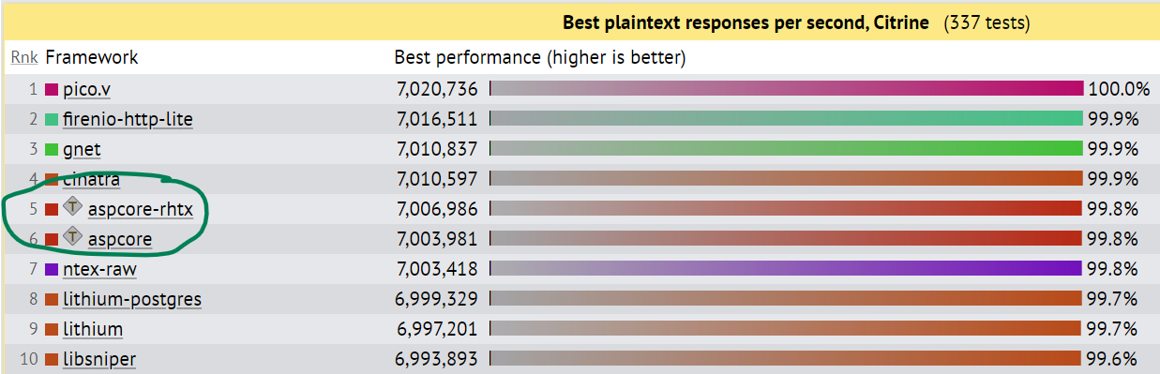
TechEmpower
Focused previously on “plaintext” benchmark
For .NET 5, focused on improving “JSON serialization” and “Fortunes”
Improvements up and down the stack
Sockets, Pipelines, System.Text.Json, DB provider, Kestrel, …

Slide 15
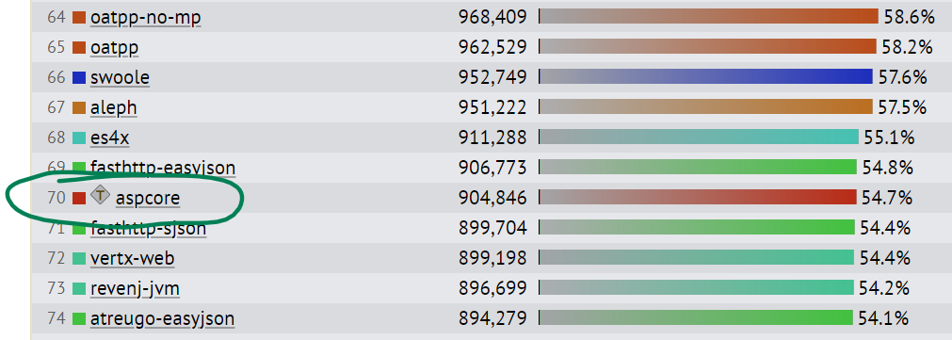
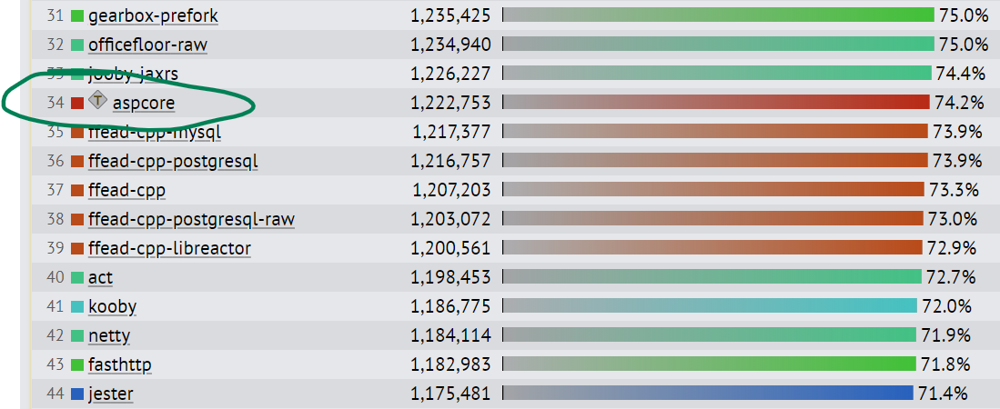
TechEmpower, cont.
JSON serialization
Round 19 results - TechEmpower Framework Benchmarks
.NET Core 3.1
TechEmpower Framework Benchmarks (daily run 9/25/2020)
.NET 5

Slide 16
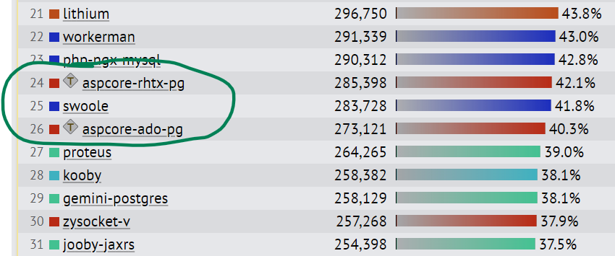
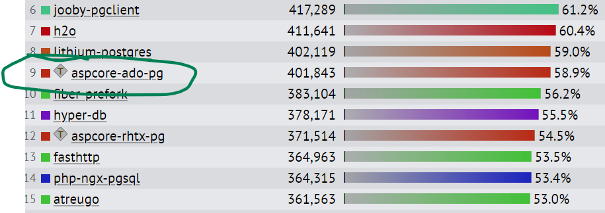
TechEmpower, cont.
Fortunes
Round 19 results - TechEmpower Framework Benchmarks
.NET Core 3.1
TechEmpower Framework Benchmarks (daily run 9/25/2020)
.NET 5

Slide 17
HTTP/2
// Server
using Microsoft.AspNetCore.Builder;
using Microsoft.AspNetCore.Hosting;
using Microsoft.AspNetCore.Http;
using Microsoft.Extensions.Hosting;
Host.CreateDefaultBuilder(args).ConfigureWebHostDefaults(b => b.UseStartup<Startup>()).Build().Run();
public class Startup
{
public void Configure(IApplicationBuilder app, IWebHostEnvironment env)
{
app.UseRouting();
app.UseEndpoints(endpoints => endpoints.MapGet("/", context => context.Response.WriteAsync("Hello")));
}
}
// Client
private HttpMessageInvoker _client = new HttpMessageInvoker(new SocketsHttpHandler());
private HttpRequestMessage _get = new HttpRequestMessage(HttpMethod.Get, new Uri("https://localhost:5001/")) { Version = HttpVersion.Version20 };
[Benchmark]
public Task Get() => // 50_000 HTTP/2 GET requests
Task.WhenAll(Enumerable.Range(0, 100).Select(async _ =>
{
for (int i = 0; i < 500; i++)
{
using (HttpResponseMessage r = await _client.SendAsync(_get, default))
using (Stream s = await r.Content.ReadAsStreamAsync())
await s.CopyToAsync(Stream.Null);
}
}));

Slide 18
Contributions Very Welcome!
~20% of perf PRs in .NET 5 were external to Microsoft
Something you want to see improved? Submit PRs. ☺
Performance improvements in .NET Core 2.0
https://devblogs.microsoft.com/dotnet/performance-improvements-in-net-core/
Performance improvements in .NET Core 2.1
https://devblogs.microsoft.com/dotnet/performance-improvements-in-net-core-2-1/
Performance improvements in .NET Core 3.0
https://devblogs.microsoft.com/dotnet/performance-improvements-in-net-core-3-0/
Performance improvements in .NET 5
https://devblogs.microsoft.com/dotnet/performance-improvements-in-net-5/

Slide 19

Q&A

